Slide 1
Accountancy
Lesson 3
Reconstitution of a partnership firm-
Admission of a partner
Topic: Accounting ratio

Slide 2
Accounting ratios ,an important subset of financial ratios.
They are a group of metrics used to measure the efficiency and profitability of a firm based on it’s financial reports.
They provide a way of expressing the relationship between one accounting data point to another and are the basis of ratio analysis.

Slide 3
Types of ratio
New profit sharing ratios.
Sacrificing ratio.
New profit sharing ratio
On the admission of a new partner, the old partners sacrifice a share of their profit in favour of the new partner.
The share of the new partner and how he will acquire it from the existing partners is decided mutually among the old partners and new partners.
The new partner acquire his share from the old partner in the name of profit sharing ratio.

Slide 4
On admission of a new partner, the profit sharing ratio among the old partners will keep changing on their respective contribution to the profit sharing ratio of the incoming partner.
Still there is a need to fix the new profit sharing ratio among all the partners.
NEW PROFIT SHARING RATIO = OLD SHARE- SACRIFICING SHARE.
Sacrificing ratio
The ratio in which the old partners agree to sacrifice their share of profit in favour of the incoming partner is called sacrificing ratio.
The new partner is required to compensate the old partner’s for their loss of share in their surplus profit of the firm for which he brings up additional amount known as premium or goodwill.

Slide 5
This amount is shared by the existing partners in the ratio in which they sacrifice their shares in favour of the new partner which is also as called sacrificing ratio.
SACRIFICE BY A PARTNER =OLD SHARE OF PROFIT-NEW SHARE OF PROFIT.

Slide 6
Example sum
Abha and Bimal are partners in a firm sharing profits and losses in the ratio of 3:2. On 31st March, 2015 they admitted Chintu into partnership for 1/5th share in the profits of the firm. On that date their Balance Sheet stood as under:
Capitals: Abha 1,20,000 Bimal 1,00,000 General reserve Sundry creditors | 2,20,000 20,000 1,00,000 3,40,000 | Plant and machinery Furniture Investments Sundry debtors Bank | 1,30,000 25,000 1,00,000 50,000 35,000 3,40,000
Liabilities Amount Assets Amount

Slide 7
Chintu was admitted on the following terms:
(i) He will bring `80,000 as capital and `30,000 for his share of goodwill premium.
(ii) Partners will share future profits in the ratio of 5 : 3 : 2.
(iii) Profit on revaluation of assets and reassessment of liabilities was `7,000.
(iv) After making adjustments, the Capital Accounts of the partners will be in proportion
to Chintu’s capital. Balance to be paid off or brought in by the old partners by cheque
as the case may be.
Prepare the Capital Accounts of the partners and Bank Account.

Slide 8
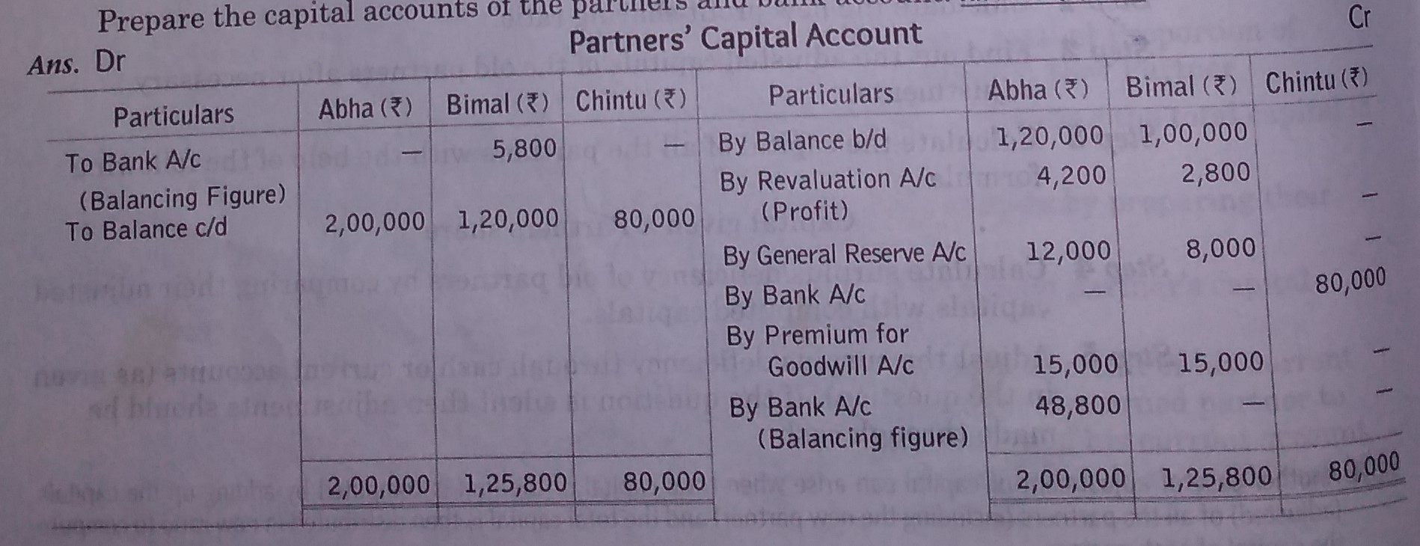
Answer:

Slide 10
Working note
Calculation of sacrificing ratio
Sacrificing ratio= old share- new share
Abha=3/5 - 5/10 = 6-5/10, Bimal=2/5 -3/10 = 4-3/10 =1/10
Sacrificing ratio = 1:1
Calculation of new capitals
Chintu’s share = 1/5
Capital brought in by chintu for 1/5th share = ₹80,000
Firm’s capital = 80,000* 5/1 = ₹ 4,00,000
Abha’s capital = 4,00,000* 5/10 = ₹ 2,00,000
Bimal’s capital = 4,00,000* 3/10 = ₹ 1,20,000
Chintu’s capital = 4,00,000* 2/10 = ₹ 80,000

